Slide 1

TERVE AFRIKKA KEHITYSYHTEISTYÖ RY TAKRY HEALTH AFRICA DEVELOPMENT CO-OPERATION ORGANISATION HADCO January 2013 Merja Seppälä
Health Africa Development Co-operation Organization (HADCO)
is a non-governmental organization (NGO) established in the year 1999 and comprises today eight Universities of Applied Sciences in the fields of Health Care, Social Work and Nutrition in Finland.
prior to registration 1996 – 1999 activities were run as Uganda Network

Slide 2
TERVE AFRIKKA KEHITYSYHTEISTYÖ RY TAKRY HEALTH AFRICA DEVELOPMENT CO-OPERATION ORGANISATION HADCO
8 universities in Finland:
Centria UAS,Häme UAS, Kajaani UAS, Kemi-Tornio UAS, Mikkeli UAS, Seinäjoki UAS, Tampere UAS, Vaasa UAS
Partners in Africa:
Maseno University Kenya (from 2004 ->)
Public Health Nurses´ College, Kampala, Uganda (to 2010)
International Health Sciences University, Kampala, Uganda (from 2011)

Slide 3
The objectives of the joint activities
The overall objective of the joint activities is to maintain, support and develop cooperation in the fields of Social and Health Care, Nutrition, Technology and Music and Art Education between Kenya, Uganda and Finland. The project also aims at raising the standards and improving the quality of Social and Health Care in those countries.

Slide 4
The objectives of the joint activities
- are to exchange information, share experiences and expertise, and promote the professional development of students and teachers through international and intercultural cooperation.
In practical terms the collaboration means student mobility, teaching staff mobility, applied research and the development of curricula, course contents, teaching methods and materials, and all joint projects aiming to promote social and health care education

Slide 5
Projects
HADCO works in accordance with Finland´s development policy whose main goal is to contribute to the eradication of extreme poverty from the world
Projects:
1998 – 2005
Promotion of Primary Health Care and Public Health Nurses´ Education in Uganda
partners:
- MOH, MOES, PHNC, Kampala, Uganda
Kiyeyi Health Centre, Tororo, East-Uganda
Funding: MFA Finland
-

Slide 6
Projects
Wellbeing in the Village Community, Uganda
2005 – 2011
School health
Health education
Nutrition; School meals
Curriculum development
partners:
- MOES, PHNC, Kampala
Kibuuka Memorial Primary School, Mpigi
Mpigi Health Centre
Funding: MFA Finland
-

Slide 7
Projects
NORTH-SOUTH-SOUTH Higher Education Institution Network Programme:
Health Africa-Project
2004 -2015; funding CIMO & MFA Finland
Kenya: Maseno University
Uganda: 2004-2011 Public Health Nurses´ College, Kampala
2011 -> International Health Sciences University (IHSU), Kampala
-

Slide 8
Background to the Project Development
Contacts from Finland
In December 1994 The first teachers from Central Ostrobothnia University of Applied Sciences (COU)/Unit of Social Services and Health Care visited Kampala, Uganda to meet representatives of Mannerheim League of Child Welfare (MLCW) and Ministry of Health (MOH) Uganda. The meeting resulted in an agreement on cooperation between Uganda MOH and COU and a preliminary agreement on starting student and teacher exchange

Slide 9
Negotiation Contacts and Staff Exchange UGANDA
First Exchange Period from Finland to Uganda in 1996
First visits from Uganda to Finland in1995 two experts visited Kokkola
1997 Assistant Commissioner J.K.Gaifuba Ministry of Health and Principal C.H. Alura Public Health Nurses’ College visited the Uganda Network partners. The preliminary official cooperation agreement was signed during the visit.

Slide 10
Negotiation Contacts and Staff Exchange UGANDA
Latest Staff Visit from UGANDA to Finland from 12th March to 23rd March 2012
Senior Lecturer, Mrs. Elizabeth Situma from International Health Sciences University (IHSU) visited Kemi – Tornio UAS and Central Ostrobothnia UAS, Kokkola for two weeks.

Slide 11
Negotiation Contacts and Staff Exchange KENYA
First Staff Visit from Kenya to Finland in 2004
Deputy Vice Chancellor, Professor Philip Aduma and Senior Lecturer, Mrs Doreen A.M. Othero visited Kokkola, Seinäjoki and Helsinki for 2 weeks.

Slide 12
Negotiation Contacts and Staff Exchange KENYA
Latest Staff Visit from Maseno University, Kenya to Finland
Lecturer, Mrs. Olympia Jelagat Keino – Okal and
Nursing Officer, Mrs. Caren Imbukwa Asilwa
visited Kemi, Kokkola, Vaasa, Seinäjoki, Tampere and Helsinki for one month 20th March to 16th April 2011
Dr. Rose Omolo – Ongati visited Seinäjoki and Kokkola for two weeks 30th August – 9th September 2011
Mr. Japheths Ogendi and Ms. Linda Mogambi visited Helsinki, Kokkola, Seinäjoki, Hämeenlinna and Tampere from 2nd May to 26th May 2012.

Slide 13
Student and Teacher exchange between Finland, Kenya and Uganda
FROM AFRICA TO FINLAND
27 Students from Uganda in the years 2000 – 2012, study placements in all member Universities of Applied Sciences
41 students from Maseno University Kisumu, Kenya in the years 2004 – 2012, study placements in all member Universities of Applied Sciences
Total number of teachers / staff 40 from Africa to Finland
FROM FINLAND TO AFRICA
Finnish Students: Twice a year in 3 months period
1996 - 2012: Total of 460 health care/social services/nutrition students + performing arts/music students15; total 475 students
* 60 Finnish Teachers from Finland to Africa

Slide 14
Members of HADCO in the Year 2013
Centria UAS Kokkola
Häme UAS Hämeenlinna
Kajaani UAS Kajaani
Kemi-Tornio UAS Kemi
Mikkeli UAS Mikkeli
Tampere UAS Tampere
Seinäjoki UAS Seinäjoki
Vaasa UAS Vaasa
Individual members approx. 20

Slide 15
The Board of HADCO 2012 – 2014
Members Deputy Members
Merja Seppälä Chairperson, Kokkola
Helli Kitinoja Vice-Chair, Seinäjoki Annikki Pulkkinen, Kemi
Anitta Juntunen, Kajaani Elisabet Montonen, Mikkeli
Essi Korkiakoski,Treasurer Kaisa Seppälä, Hämeenlinna
Ilmo Anttila, Kokkola Helinä Mesiäislehto-Soukka
Seinäjoki
Päivi Hautaviita, Tampere Gitte Taulo, Tampere
Leila Latvasalo Senior Chairperson

Slide 16
The Millennium Development Goals
Reduce by a half both the proportion of the world’s population who live in extreme poverty and the proportion suffering from hunger
2. Ensure primary education for all children

Slide 17
The Millennium Development Goals
4. Eliminate gender inequality at all levels of education
5. Reduce the mortality rate for children under five by two thirds
6. Reduce the maternal mortality rate by three quarters

Slide 18
The Millennium Development Goals
6.Halt, and start to reverse, the spread of HIV/Aids, malaria and other major diseases
7.Ensure the sustainable development of the environment and, amongst other targets, halve the proportion of people without sustainable access to safe drinking water
8.Create a global partnership for development

Slide 19
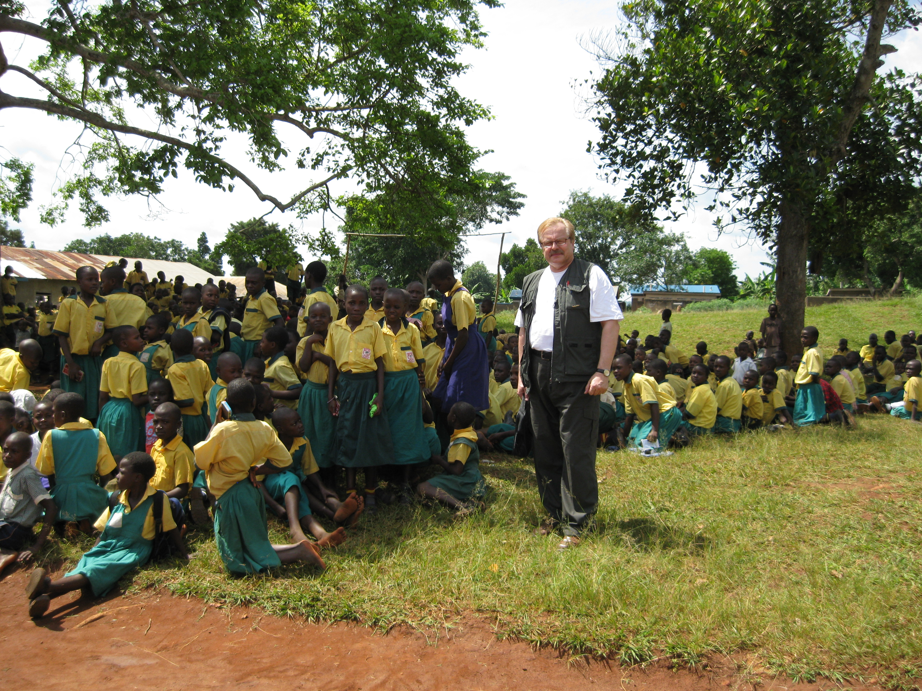

Slide 20
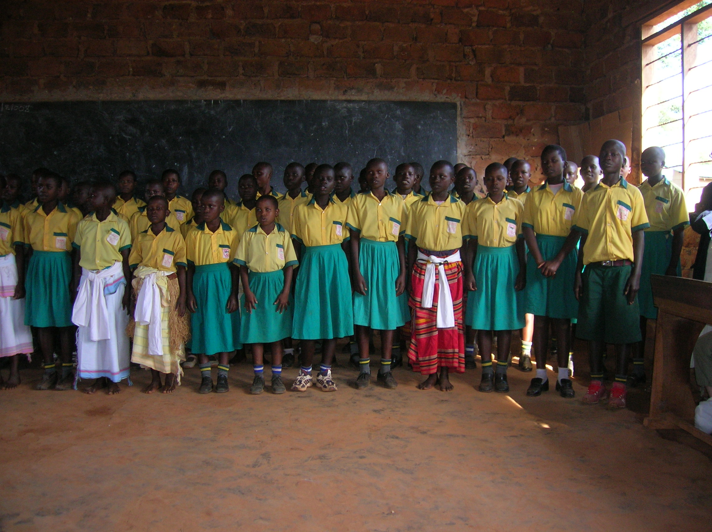

THANK YOU!

Slide 21
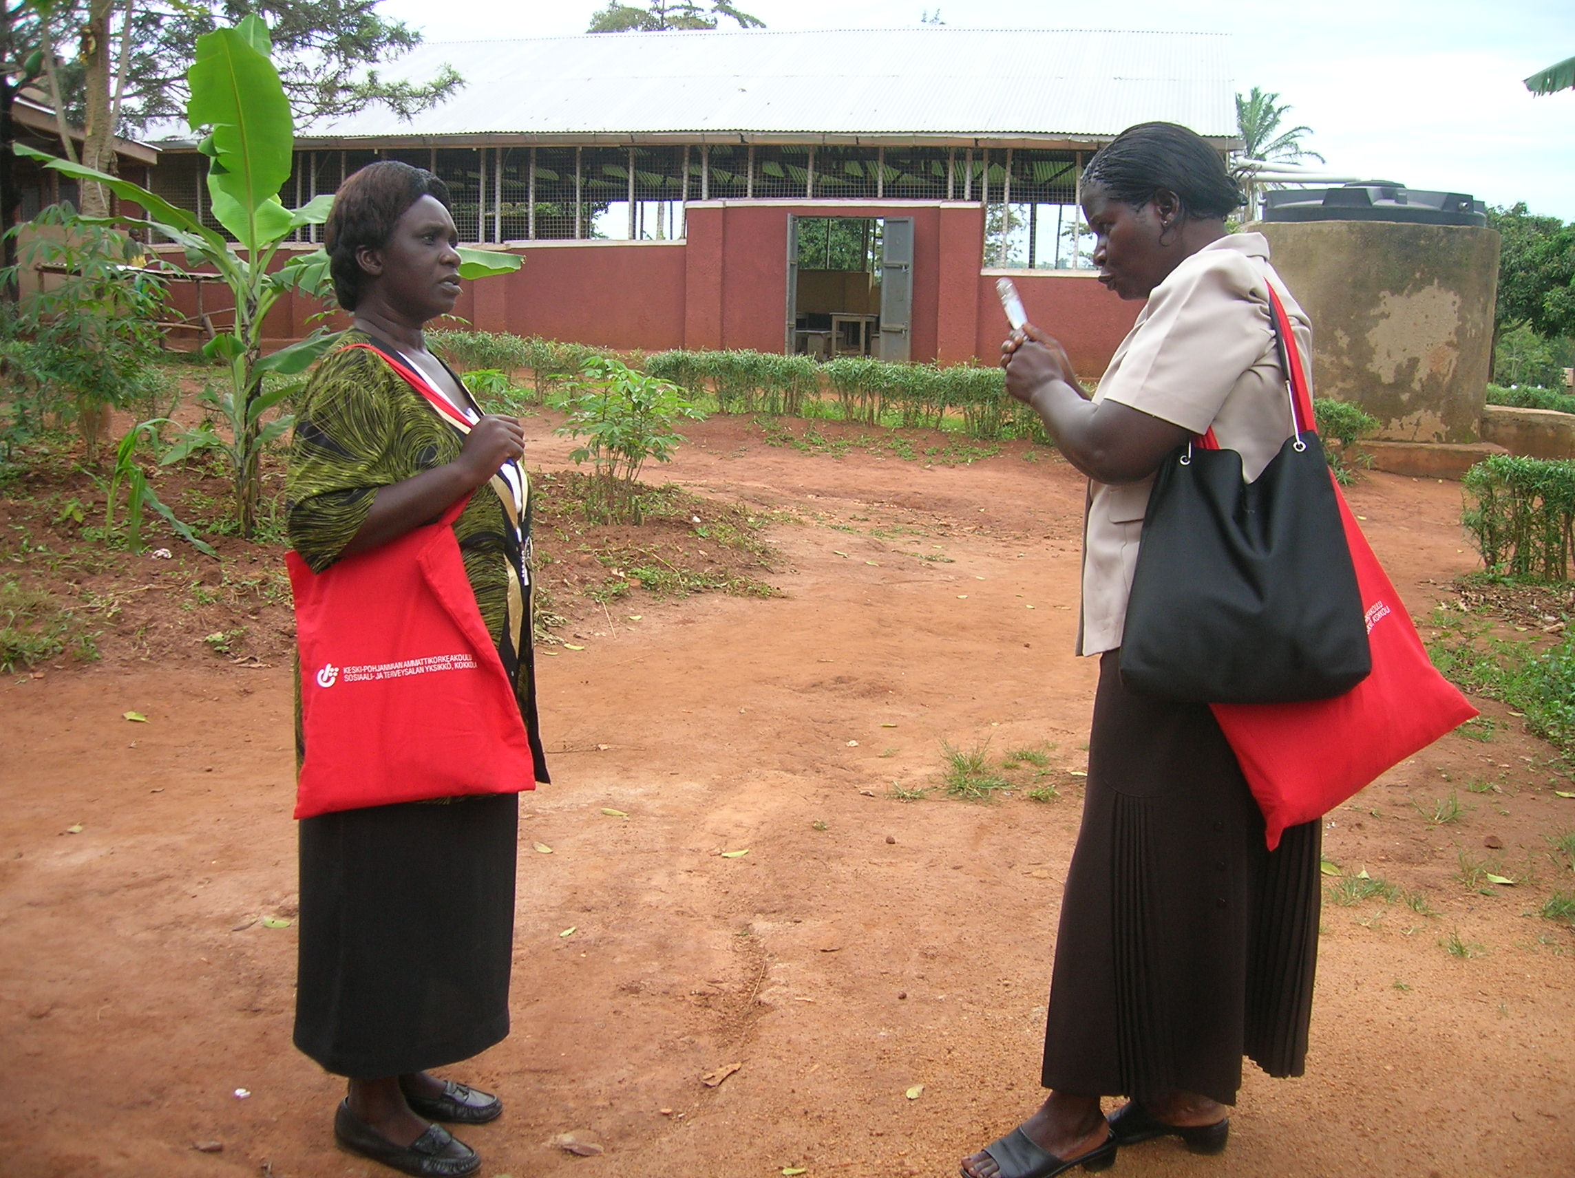
6.Halt, and start to reverse, the spread of HIV/Aids, malaria and other major diseases
7.Ensure the sustainable development of the environment and, amongst other targets, halve the proportion of people without sustainable access to safe drinking water
8.Create a global partnership for development

Slide 22
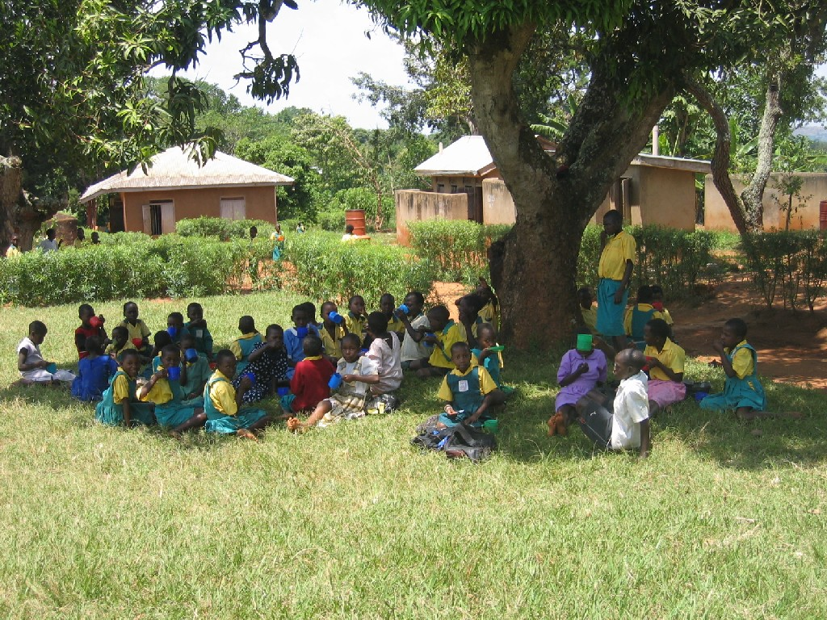

Slide 23
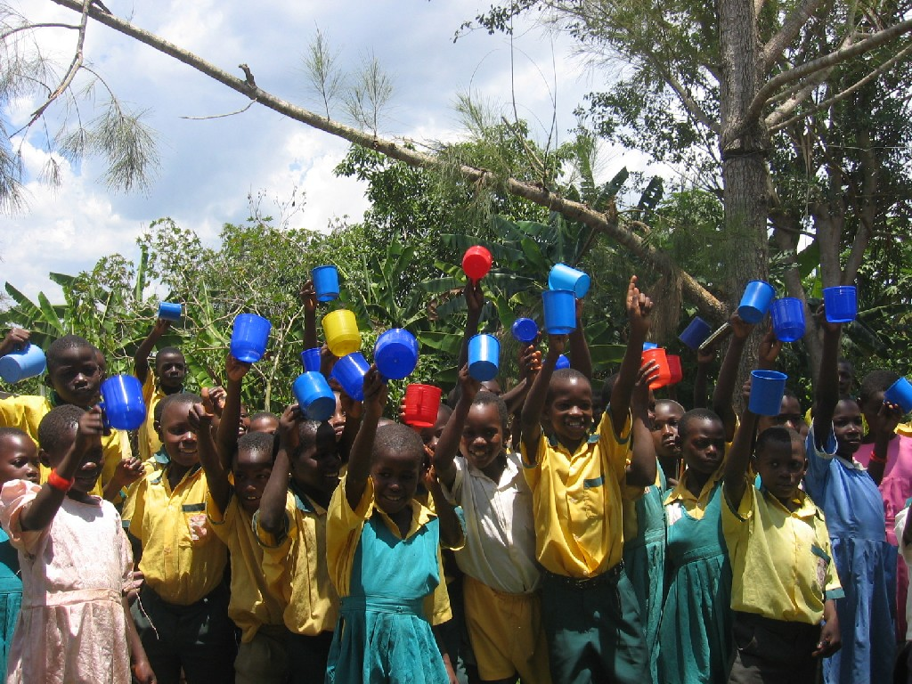

Slide 24
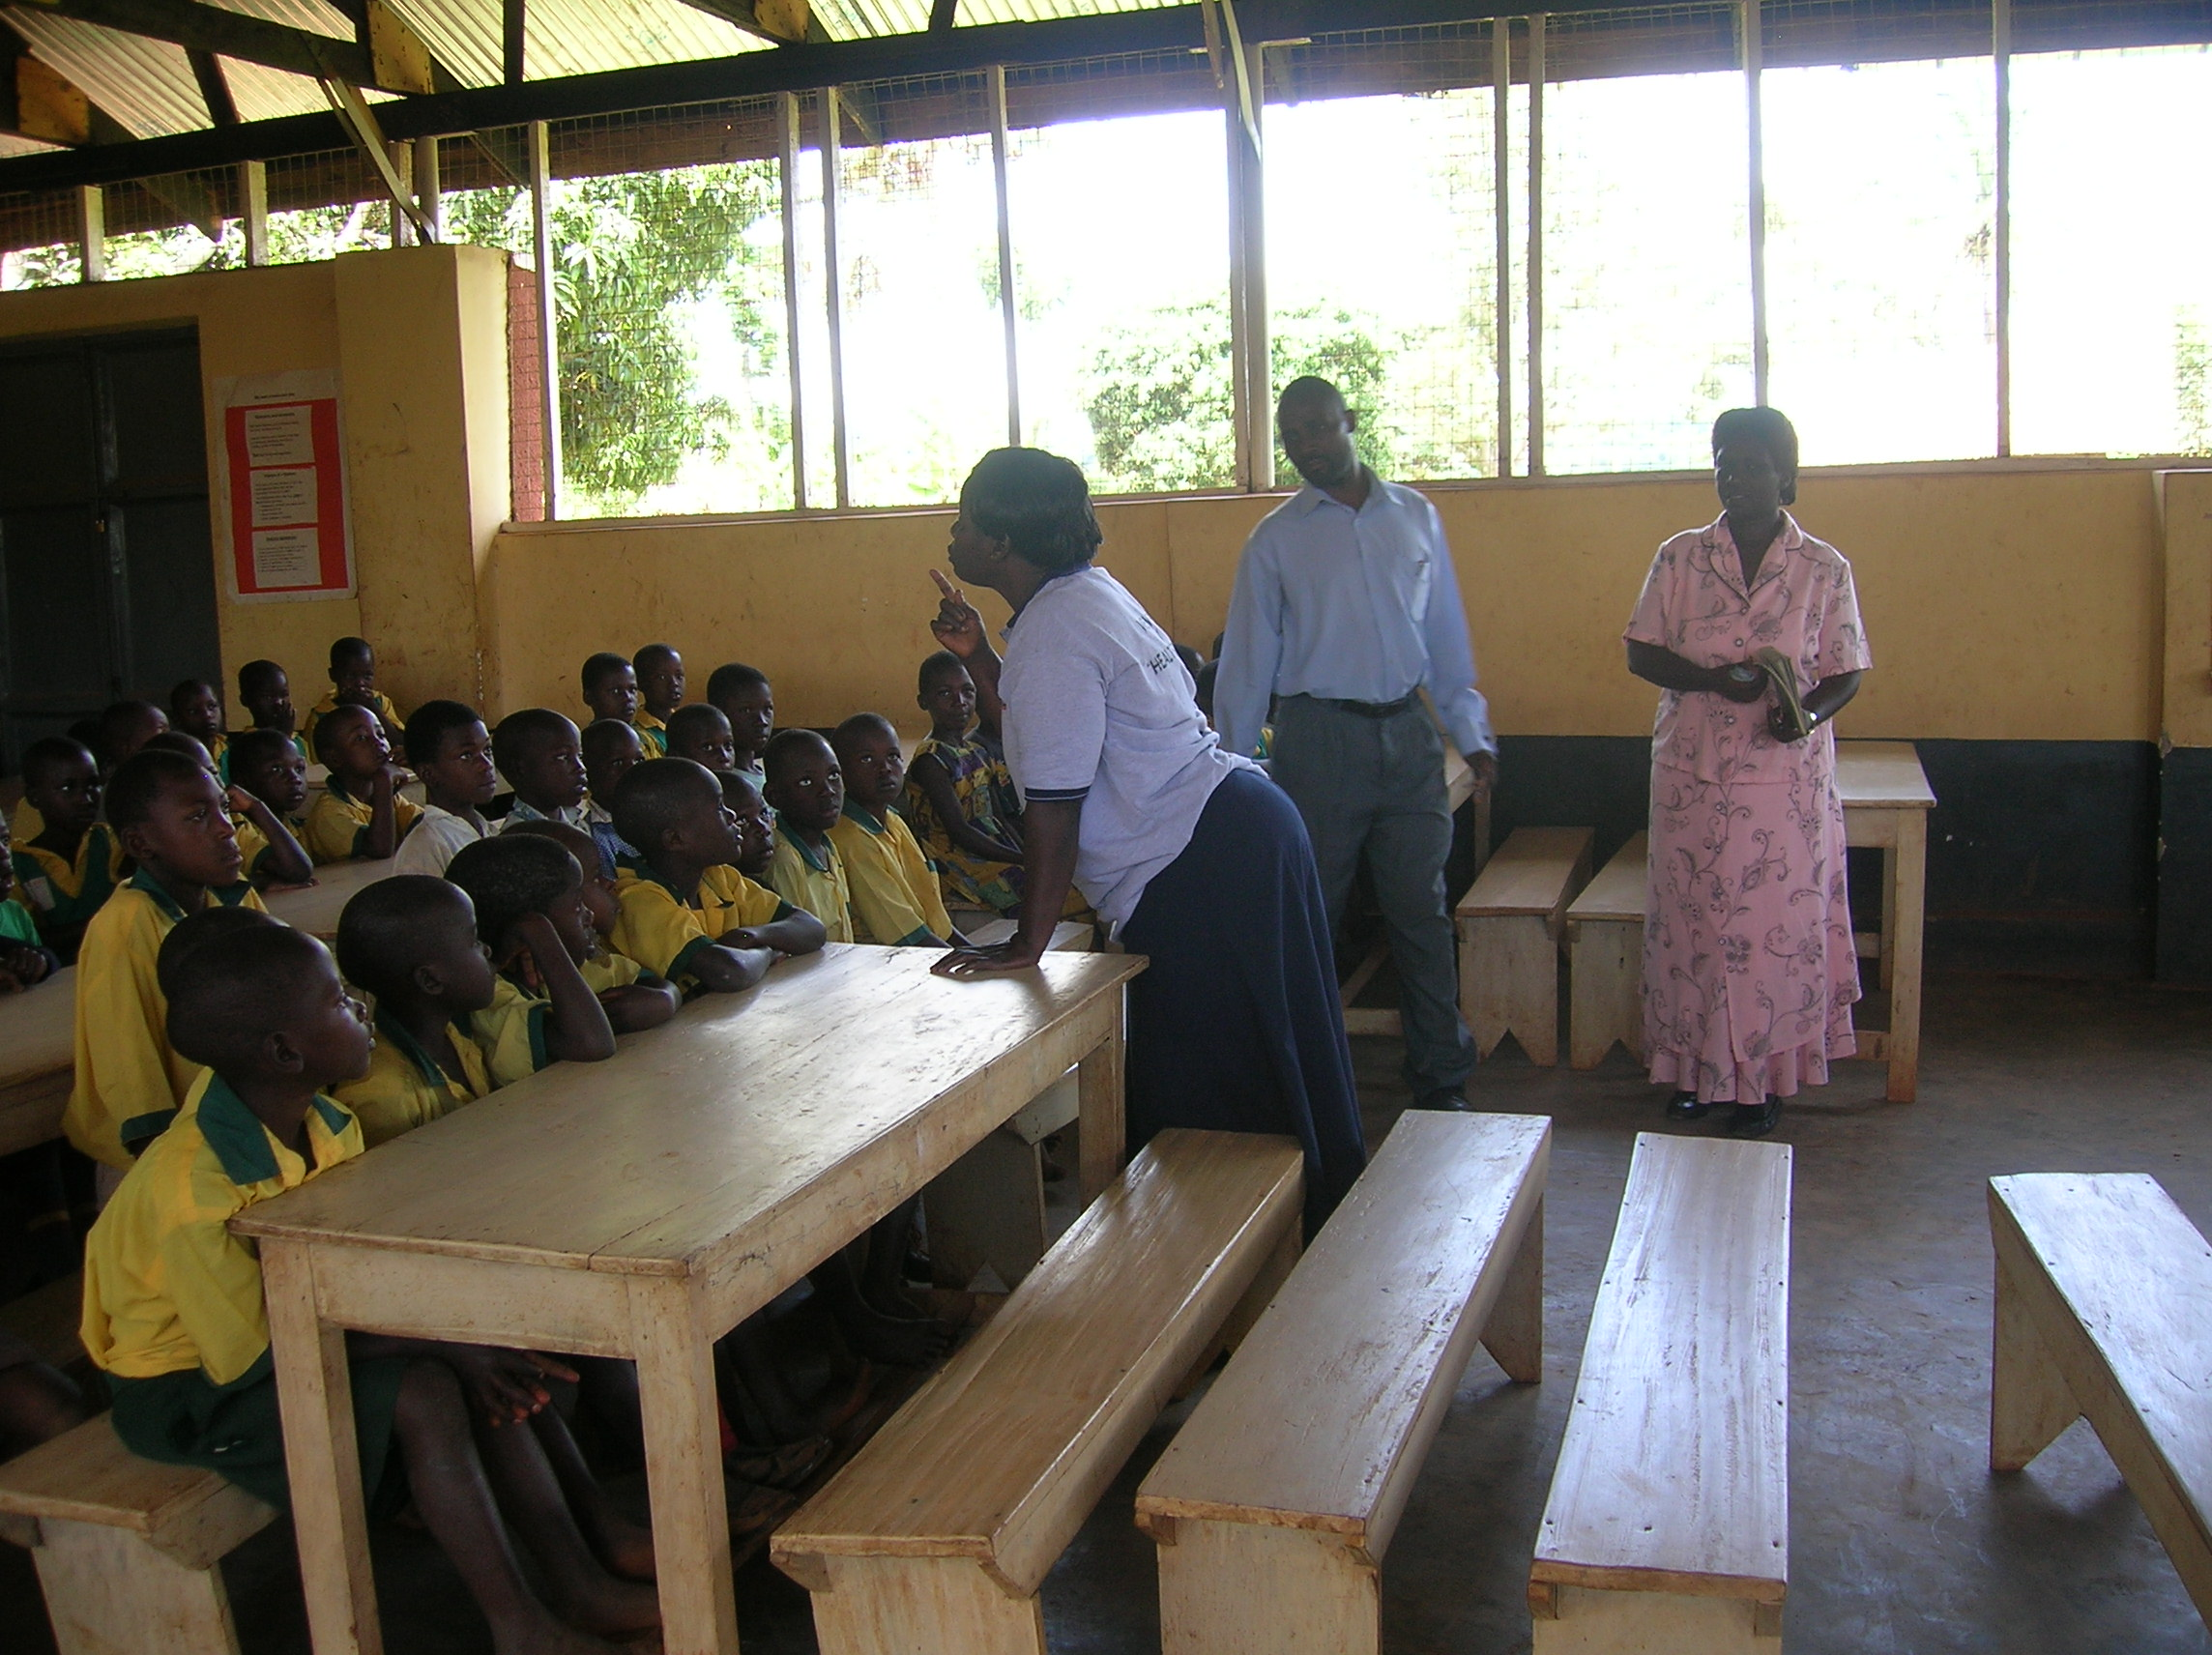

Slide 25
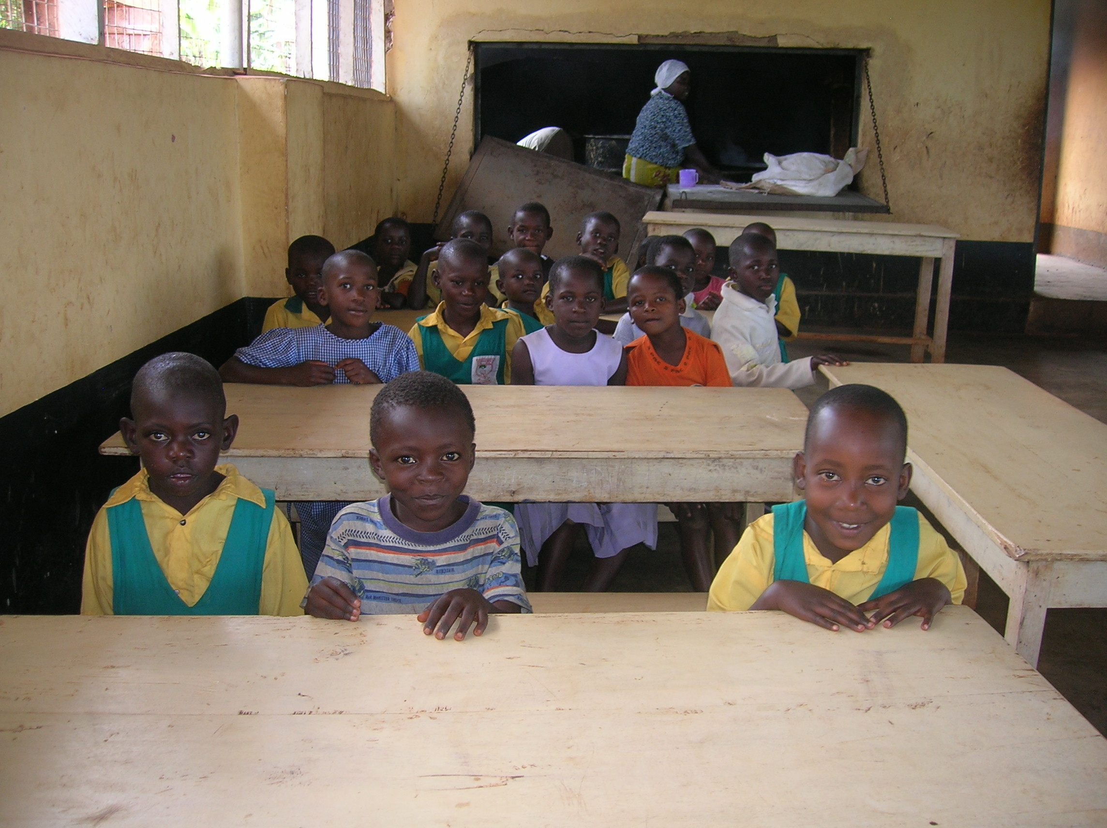

Slide 26
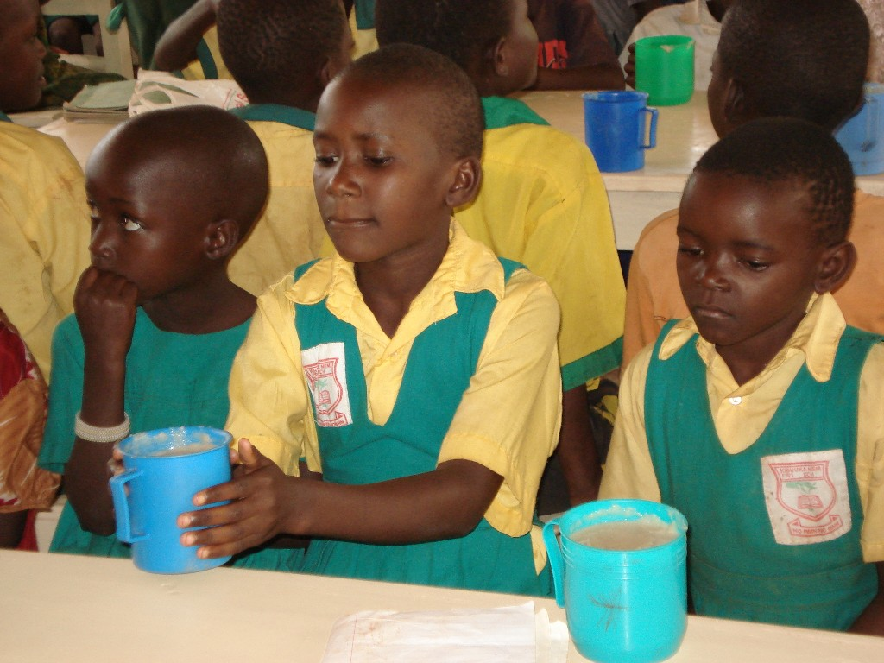

Slide 27
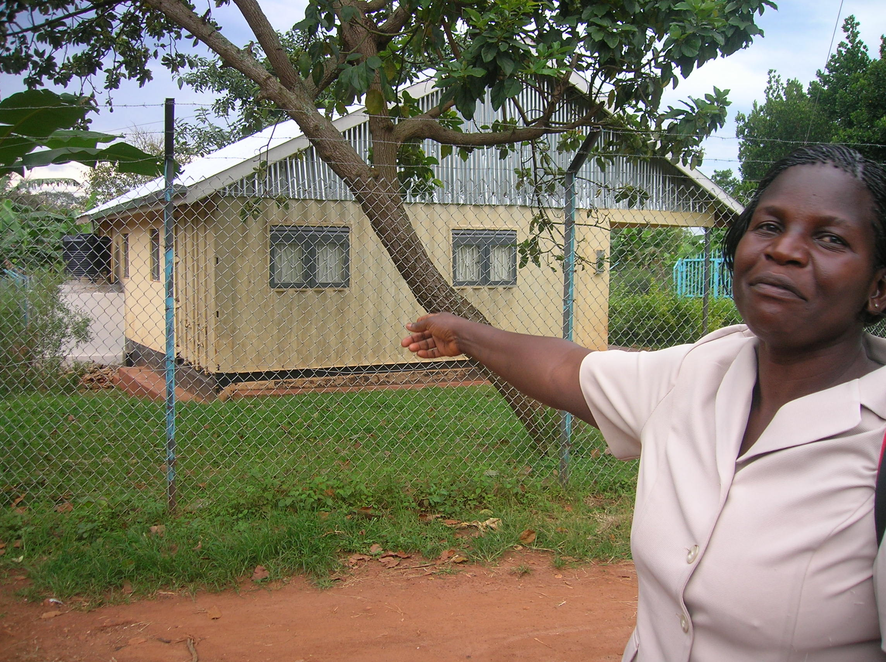

Slide 28
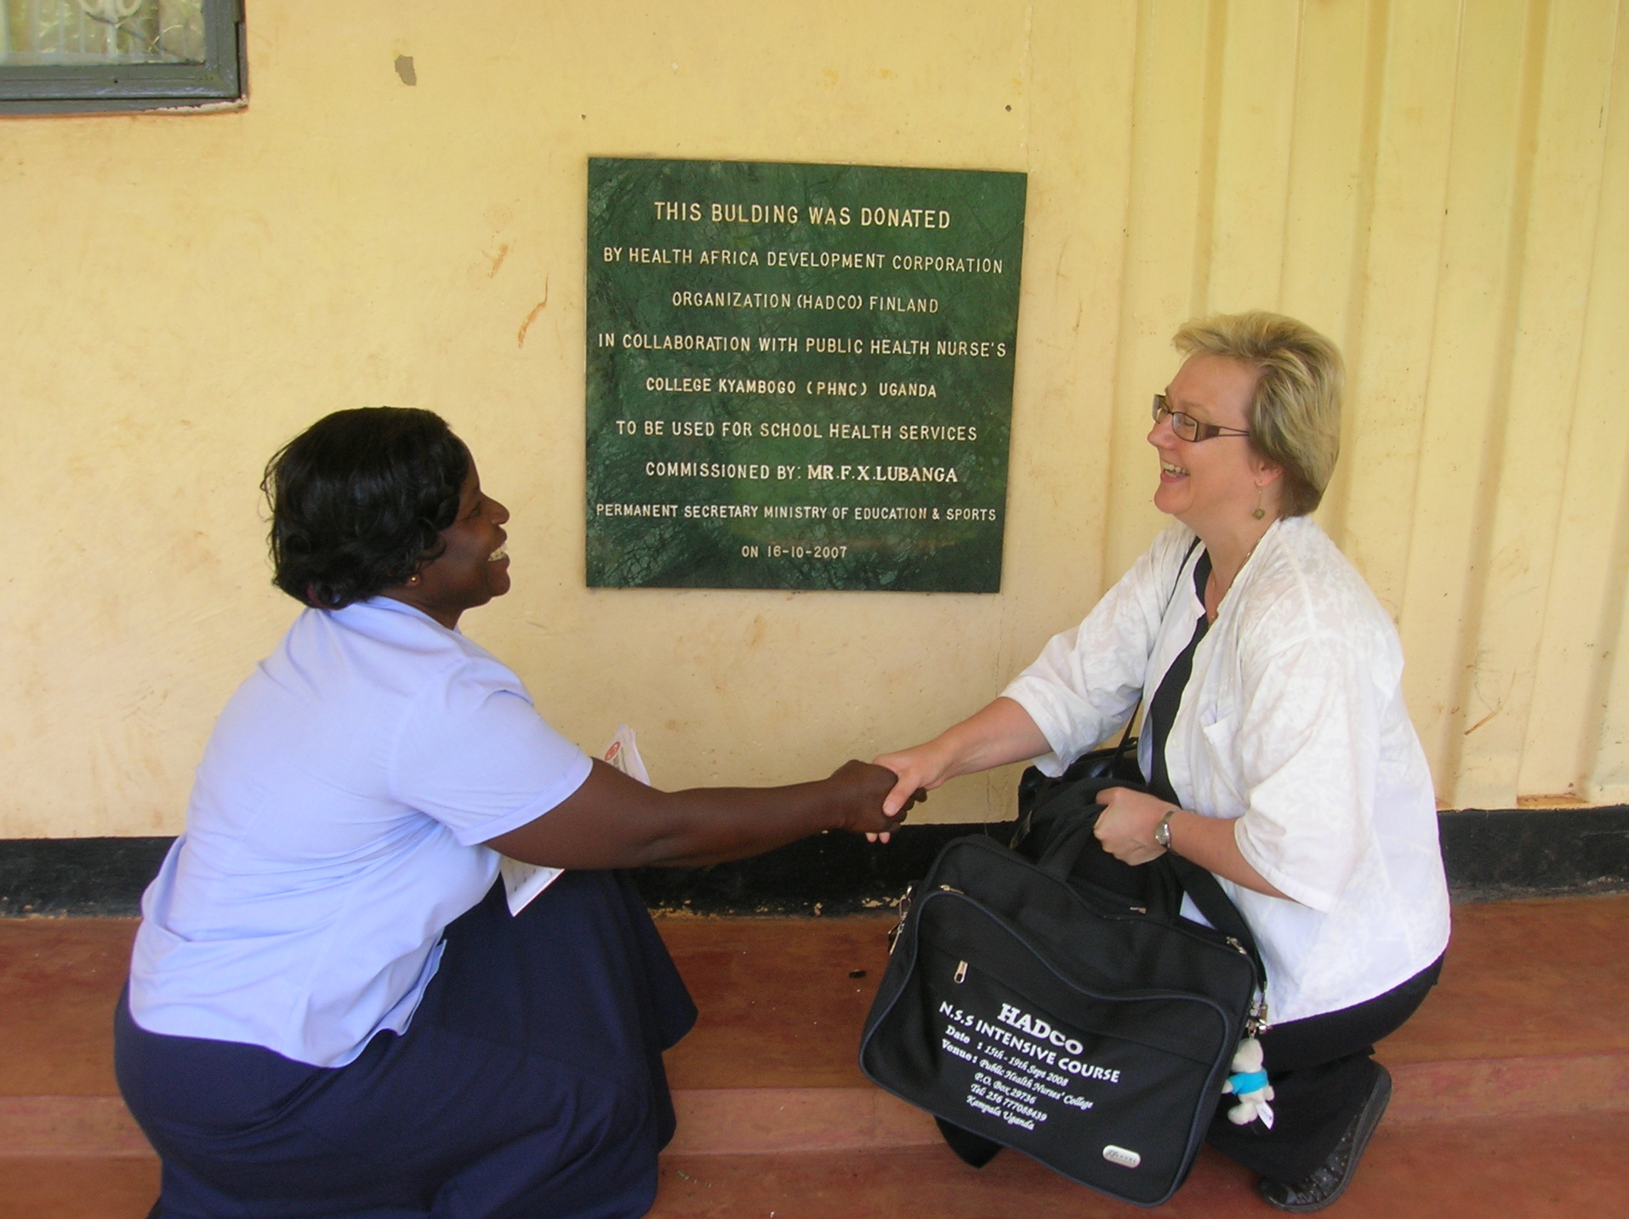

Slide 29
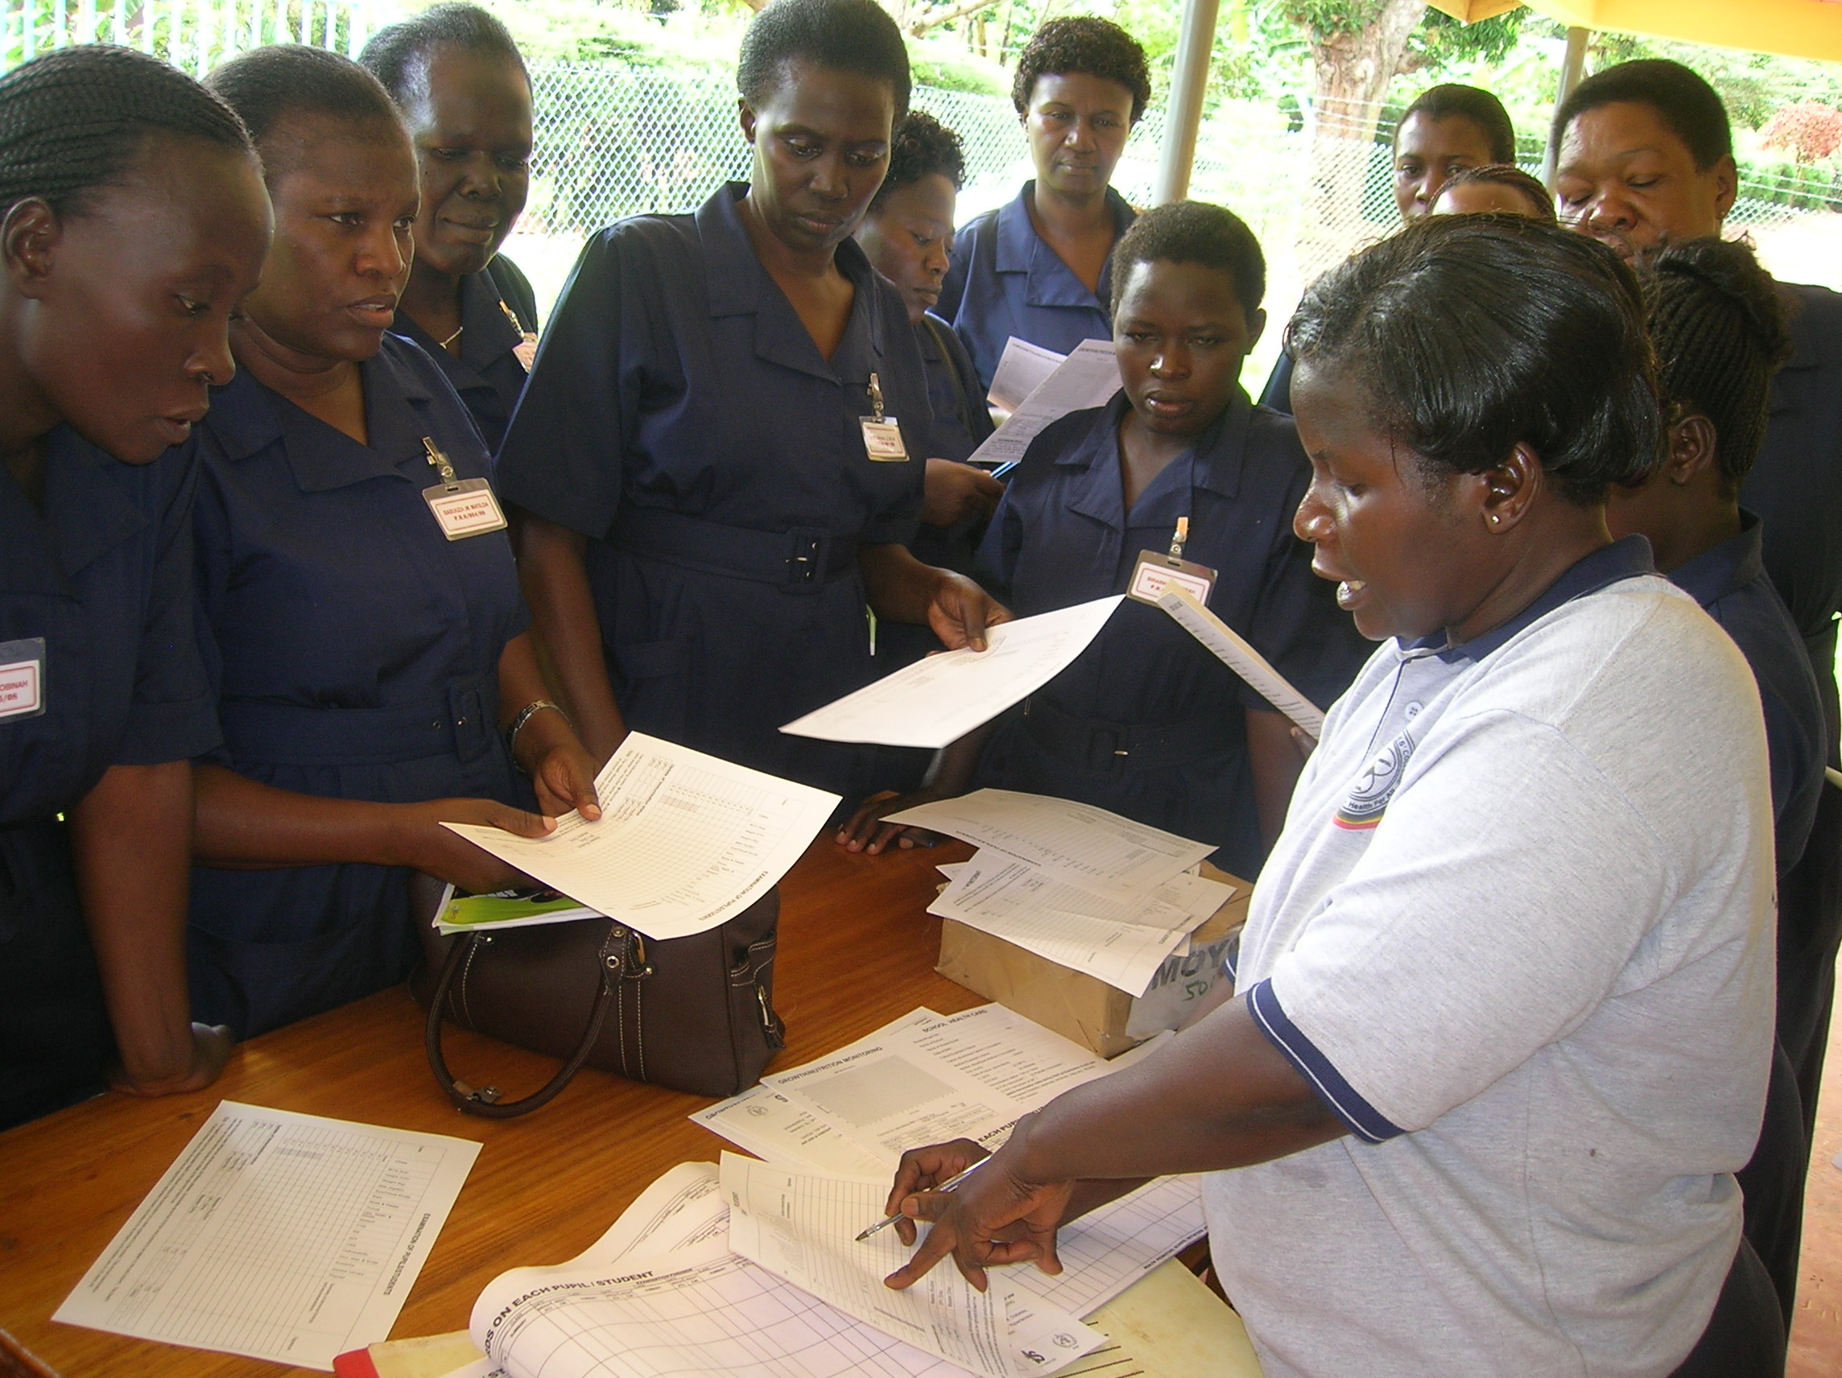

Slide 30
